Slide 1
BATCH-CSE-052
TEAM:CONQUERORS
1) GUNDA ROHITH
2) THALLADA SAITEJA
3) PENDLI SURYATEJA
4) KANDUGULA PRANITH
PREDICITING CO2 EMISSION IN VEHICLES

Slide 2
INTRODUCTION
When a petrol or diesel engine burns fuel it produces carbon dioxide (CO2), along with a handful of other harmful gases. This CO2 is then emitted through the vehicles exhaust pipe. The amount of CO2 in a vehicle emits into the atmosphere is measured in grams per kilometre - often shortened to g/km - and is considered to be an indication of how kind a vehicle is to the environment.
In general, the lower this figure, the less fuel that a vehicle uses: a car with 90g/km CO2, should have good fuel economy. One with 180g/km CO2 or more will use a lot of fuel. So consumers looking to reduce their running costs ought to be looking out for cars with fewer emissions.

Slide 3
CO2 EMISSION
Carbon dioxide (CO₂) is released into Earth’s atmosphere mostly by the burning of carbon-containing fuels and the decay of wood and other plant matter. Under all conditions found naturally on Earth, CO₂ is an invisible, odourless gas. It is removed from the atmosphere mostly by plants, which extract carbon from CO₂ to build their tissues, and by the oceans, in which CO₂ dissolves
Although other gases are also causing Earth’s climate to warm, CO₂ alone is responsible for about three-fourths of global warming.
The amount of CO₂ in the atmosphere has increased greatly since human beings began burning large amounts of coal and petroleum in the nineteenth century

Slide 4
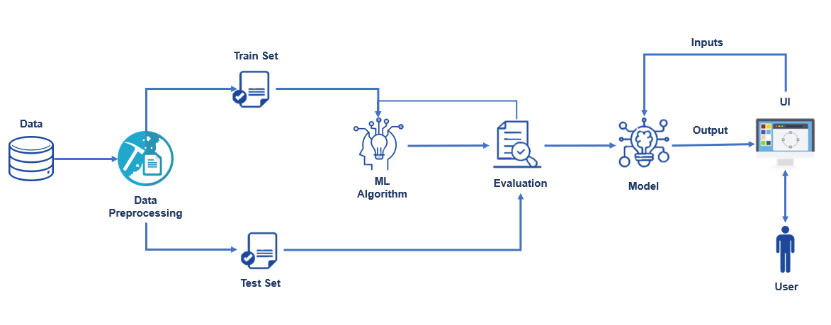
ARCHITECTURE:

Slide 5
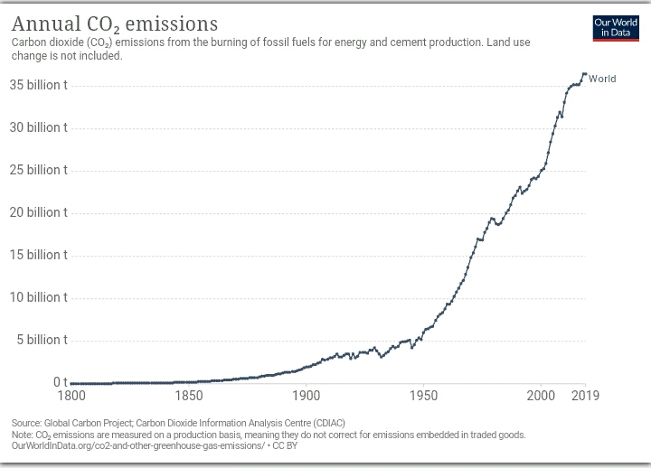
GRAPH OF ANNUAL CO2 EMISSIONS:

Slide 6
SOLUTION
What You Can Do to Reduce Pollution from Vehicles and Engines On this page :
1) Drive less
2) Drive wise
3) Choose fuel efficient vehicles
4) Don’t idle
5) Optimize home deliveries
6) Use efficient lawn and gardening equipment

Slide 7
THANK YOU

